Slide 1
I2C&SMbus Protocol Introduction
Hongli Pang
Updated :2019/9/19

Slide 2
Topics
I2C summary
I2C bus performance
Bus operation
Data /Address mode
Example :How to exchange the information by I2C bus
SMBUS

Slide 3
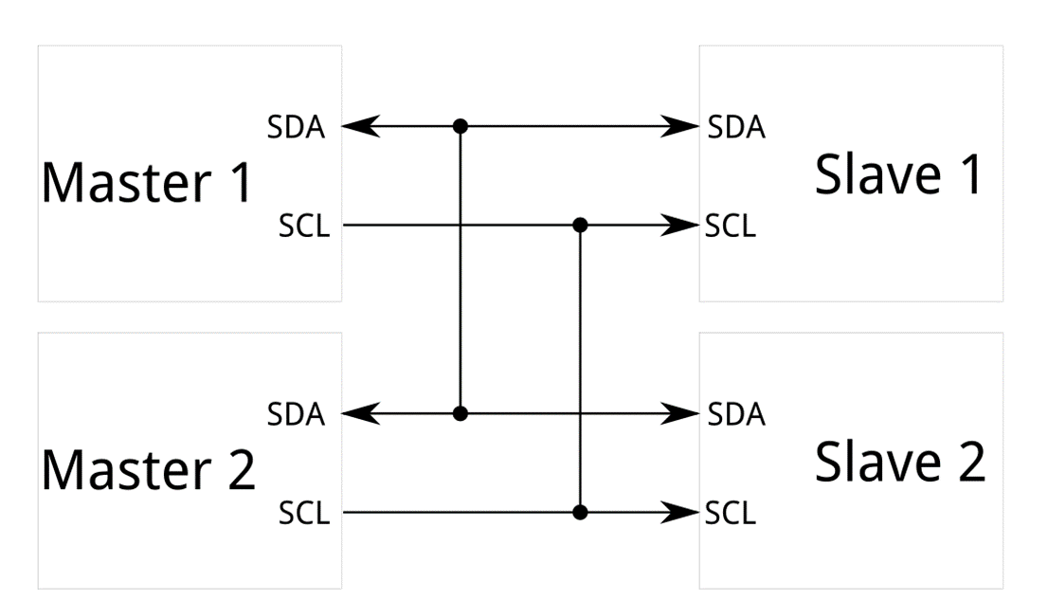
I2C Summary
What is I2C ？
I2C , Inter-integrated Circuit Bus (内部集成电路总线). It was originally developed and designed by Philips in 1982.
I2C bus supports the short range communication between the devices. It is used for the interface between the processor and some external devices. It only use two signal lines to complete the information transfer between the devices. At first it only allowed the 100kbit/s ,7-bits standard address .

Slide 4
I2C Bus performance
This kind of bus has the advantage of the fewer pins and simple hardware structure .
Two signal lines to transfer the information :SDA and SCL .
Support the 7 bits address and 10 bits address .
Support the multi-master . The same interface can act as Master or Slave mode . Allow the multiple masters and every one can communicate with all the slaves .
Support different transfer speed , there are five modes :
Standard mode (100kbit/s )
Fast mode(400kbit/s)
Fast mode+(1Mbit/s)
High speed mode (3.4Mbit/s)
Super high speed mode (5Mbit/s)

Slide 5
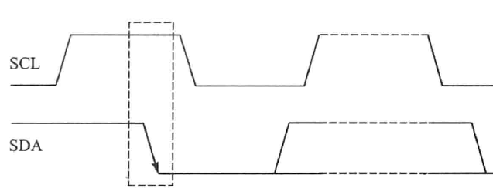
I2C bus introduction
I2C bus has two signal lines :SDA and SCL.
SDA : This data line is used to transfer the data and address . We can use it to upload the data frames and address frames .
SCL : This clock line is used to Synchronous data transmission and reception(同步数据收发).

Slide 6
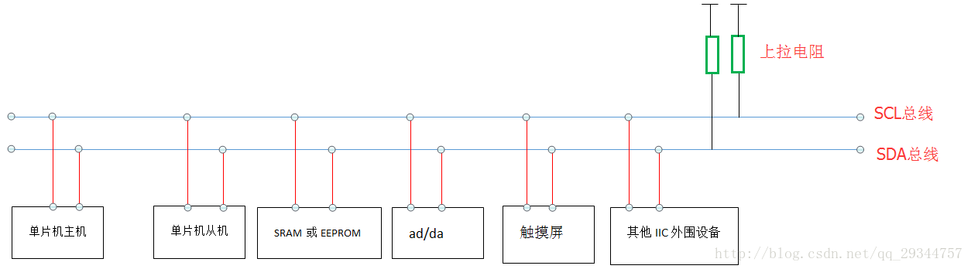
I2C bus introduction
This protocol support multi masters and slavers. There are many devices on the I2C bus . But at this moment ,only one master device can work .

Slide 7
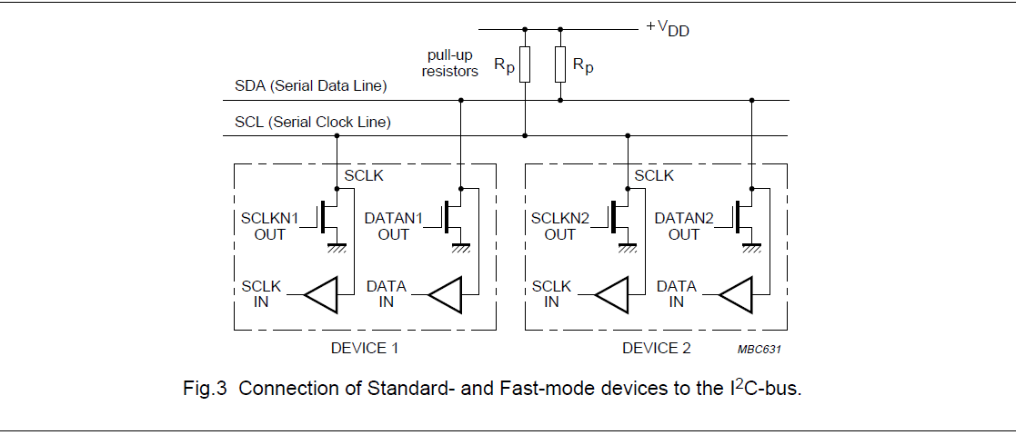
I2C bus introduction
问题：在I2C的线路连接当中，为什么要通过一个上拉电阻接电源，I2C是如何实现高低电平和线与功能的？
在这张图当中，我们使用mos管连接设备于SCLK，SDA的输出线（充当发送数据的线路），使用一个二极管连接SCLK和SDA的输入线（充当接收数据的线路）。
由于二极管的特性，当设备接收数据时，SCLKIN/DATAIN这条线就会工作，接收SCL，SDA上的数据。
当我们使用MOS管输出时，此时的结构是OD（漏极开路结构），G极（栅极）连接的是SCLKN1OUT ，D极（漏极）连接SCL/SDA总线并且通过上拉电阻接正向电源，S极（源极）接地。
MOS管的作用是相当于开关，当我们输出“0”时，相当于开关闭合，源极和漏极导通，所以总线直接接地，输出为低电平。当我们输出为“1”，相当于开关断开，源极和漏极断开，此时为漏极开路的状态，总线上根据VDD输出高电平。

Slide 8
I2C bus introduction
在实际应用中可以将多个开漏输出的引脚连接到一条线上，这样就形成“线与逻辑”关系。注意这个公共点必须接一个上拉电阻。当这些引脚的任一路变为逻辑0后，开漏线上的逻辑就为0了。在I2C等接口总线中就用此法判断总线占用状态。
上拉电阻的主要作用在于提高输出信号的驱动能力、确定输入信号的电平（防止干扰）。
上拉电阻阻值的选择原则包括:
从节约功耗及芯片的灌电流能力考虑应当足够大；电阻大，电流小。
从确保足够的驱动电流考虑应当足够小；电阻小，电流大。
对于高速电路，过大的上拉电阻可能边沿变平缓。
综合考虑以上三点，通常在1K到10K之间选取。

Slide 9
I2C bus introduction
On the bus every devices have an address for its own.
The SDA line can use MSB first transmission to send the information. Every time sends/or read 8 bits(1byte) .And the speed of data transmission is up to 3.4Mbit/s.

Slide 10
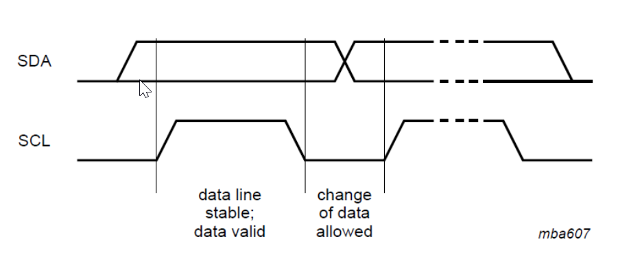
Bus operation
Data validity(数据有效性)
Each time we send a bit data on the SDA ,there is a clock pulse on the SCL correspondingly .
SCL=high , SDA can’t change SCL=low , SDA can change .
When the SCL=high , the data on the SDA line was stable .-- the data valid

Slide 11
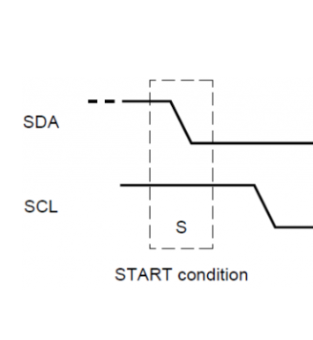
Bus operation
Start condition
I2C use the SDA and SCL combination to express start signal and stop signal.
When the SCL =high and the SDA changes from high to low , this condition there is a start signal .
It comes from the master and after this start signal the bus is busy to transmission the data. Master can repeat sending start signal not send stop signal .
This means the bus is also on busy status and send the data .

Slide 12
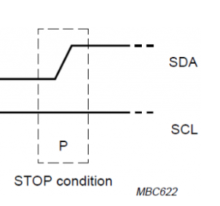
Bus operation
Stop condition
When the SCL =high and the SDA changes from low to high , this condition there is a stop signal .
It comes from the master and after this stop signal the bus is not busy .
It means the transmission of the data is over .

Slide 13
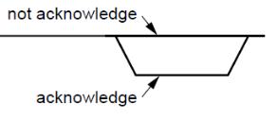
Bus operation
Respond signal (ack/nack)
When a receiver receive the address or the data, the receiver should respond with the acknowledgement signal to the sender on the SDA line .
If receiver wants to send a ack signal ,it must meet these requirements :
On the clock pulse for acknowledgement ,the sender will release control of SDA .So the receiver will use the SDA line to respond a signal to express the ack/nack .
send ack :SCL=high &&SDA=low

Slide 14
Bus operation
问题：为什么ACK信号是低电平？
我认为ACK信号为低电平是因为总线的空闲状态为高电平。在ACK时钟周期期间，发送方会释放SDA，放弃SDA的控制权。此时的SDA线为空闲状态（高电平），为了区分ACK信号的产生，当接受方控制SDA线拉低，表示ACK信号。（为了区分总线的空闲状态，防止发生混淆：如果ACK信号为高电平，那么此时无论是否有接收方控制SDA输出ACK信号，此时的SDA线上都为高电平，这种情况就造成了混淆）

Slide 15
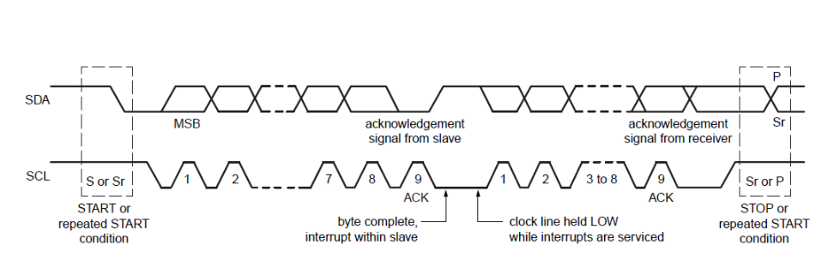
Bus operation
Byte format
On the SDA the data need to be transmitted must be 8 bits long . Each transmission the data doesn’t define how many byte should be sent .
But every time when the transmission of the byte(8bit) data is complete , the slaver(receiver) need to sent a acknowledgement signal on the 9 bit .

Slide 16
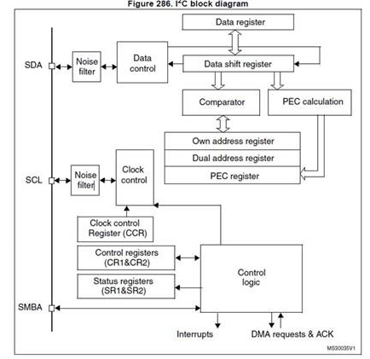
Bus operation
问题：在I2C数据的传输过程当中，1byte+ACK 的传输完成之后，为什么会有一段时间SCL总线处于低电平状态，此时的SCL总线由谁控制？
在一个字节的数据传输完成之后，接收方会返回一个应答信号。此时会由从机主动将SCL线拉低，主机进入到等待状态，直到从机完成将接受到的数据由数据移位寄存器(下图所示)转移到相应的数据寄存器当中后（或者从机充当发送方，将数据从数据寄存器上传到数据移位寄存器当中，完成下一个字节传输的准备工作），从机释放对SCL的控制。进入到下一个字节的传输环节。

Slide 17
Bus operation
这个操作是由从机进行控制的，此时有相应的中断机制进行判断，判断移位寄存器，数据寄存器是否为空，以此来判断对SCL线拉低的时间。
小结:Clock Stretching 通过拉低SCL延迟数据的传输。Clock Stretching 是可选功能。接收器在下一个字节接收前，可能需要一段时间存储上一个接收的字节。从机可以在接收字节和发送ACK后将SCL置低，通知发送器延迟数据的发送，直到从机准备好，再次将SCL释放为止。从机以一种握手机制迫使主机进入等待状态，直到从机准备好接收下一个字节。

Slide 18
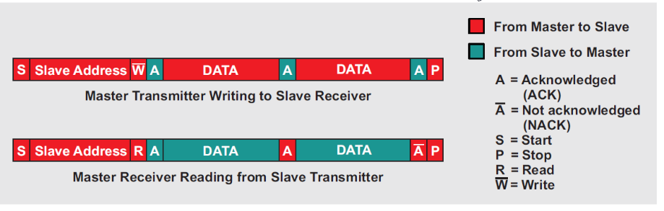
Bus operation
R/W operation
0：write
1: read

Slide 19
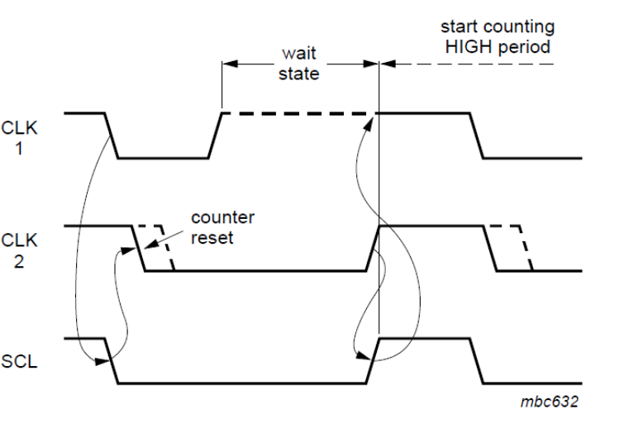
Bus operation
Clock Synchronization(时钟同步)
Synchronous clock generated in this way:
The SCL line’s low time is the longest low time of all host clocks, and its high time is the shortest high time of all host clocks.
The first CLK on high will on wait state , wait the other CLKs return high .

Slide 20
Bus operation
Arbitration(仲裁)
When there are multiple masters on the bus that send start conditions and transmit data over the bus, arbitration is required to determine which master has the right to use the bus.
We arbitrate by bit. At the beginning of the arbitration starts, for each bit of data, when SCL is high, each master detects whether the data on SDA is the same as the data sent by itself. When the master sends HIGH and detects that the level on SDA is LOW, the master loses control in arbitration and turns off its SDA Data output.

Slide 21
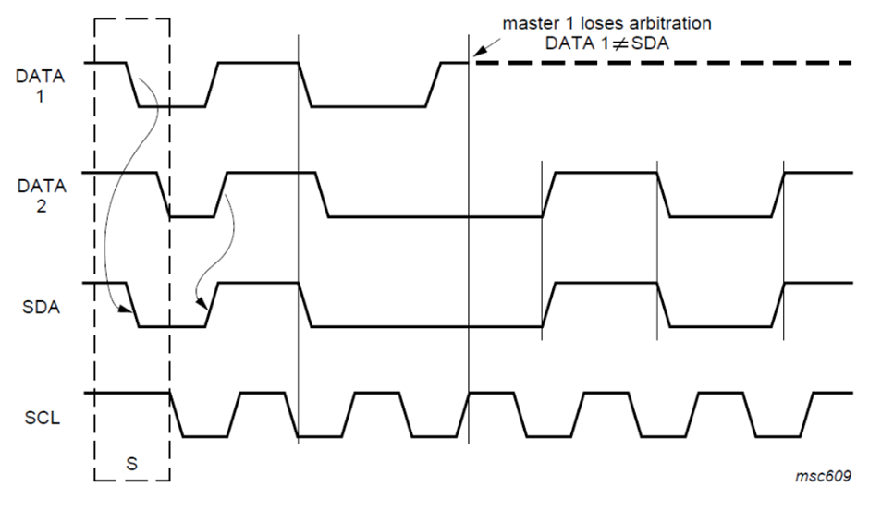
Bus operation
Arbitration(仲裁)

Slide 22
Bus operation
Here are some points of Arbitration need to care:
The losing arbitration master must switch over immediately to its slave mode. Its data line will end data transfer and on the idle state(high level), but the clock phase is generated until the end of the byte in which it loses the arbitration.(use to SCL clock Synchronization)
No information is lost during the arbitration process because address and data information on the I2C-bus is determined by the winning master.
After the winning master complete the data transmission , the losing arbitration master (now on slave mode ) can repeat send a start condition.
Because the arbitration and the bus competing ,there is no central master ,nor any order of priority of the bus.

Slide 23
Bus operation
Special attention must be paid if, during a serial transfer, the arbitration procedure is still in progress at the moment when a repeated START condition or a STOP condition is transmitted to the I2C-bus. If it’s possible for such a situation to occur, the masters involved must send this repeated START condition or STOP condition at the same position in the format frame.
In other word , arbitration isn’t allowed between:
A repeated START condition and a data bit
A STOP condition and a data bit
A repeated START condition and a STOP condition.
Slaves are not involved in the arbitration procedure.

Slide 24
Bus operation
补充
在仲裁过程中，存在以下未定条件会导致不可预期的结果：
主机1在主机2发送数据的过程中发出重复开始条件（Sr）
主机1在主机2发送数据的过程中发出结束条件（P）
主机1在主机发出结束条件（P）的过程中发出重复开始条件（Sr）

Slide 25
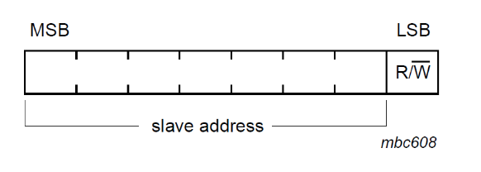
Data /Address mode
7 bits address
The first byte after the start condition includes the slave address (7bit) and the R/W operation bit(1 bit) .
0: write ;master write data to slave
1;read ; master read data from slave

Slide 26
Example :How to transfer the information by I2C bus
According to STM32 , I2C main features:
I2C Master feature:
Clock generation
Start and Stop generation
I2C Slave feature:
Programmable I2C Address detection
Dual Addressing Capability to acknowledge 2 slave addresses
Stop condition detection
Master and slave mode operational
Generation and detection of 7-bit/10-bit addressing and General Call
Supports different communication speeds:
Standard Speed (up to 100 kHz)
Fast Speed (up to 400 kHz)

Slide 27
Example :How to transfer the information by I2C bus
The interface can operate in one of the four mode:
-slave transmitter , slave receiver ,master transmitter ,master receiver .
By default , I2C interface works in the slave mode . It can switch from slave to master mode after it generates a START condition .
Communication flow
In Master mode, the I2C interface initiates a data transfer and generates the clock signal. A serial data transfer always begins with a start condition and ends with a stop condition. Both start and stop conditions are generated in master mode by software.
In Slave mode, the interface is capable of recognizing its own addresses (7 or 10-bit), and the General Call address. And it can send acknowledge bit to the master after receiver its own address in the 9th clock

Slide 28
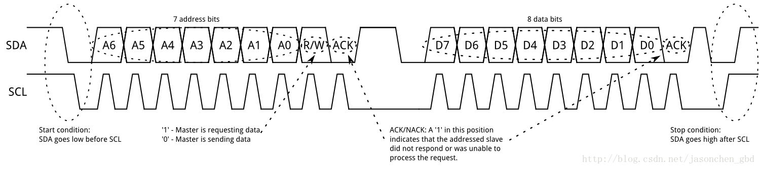
Example : How to transfer the information by I2C bus

Slide 29

Code of I2C
void Start_I2c()
{
SDA=1; //发送起始条件的数据信号
_Nop();
SCL=1;
_Nop(); //起始条件建立时间大于4.7us,延时
_Nop();
_Nop();
_Nop();
_Nop();
SDA=0; //发送起始信号
_Nop(); //起始条件锁定时间大于4μ
_Nop();
_Nop();
_Nop();
_Nop();
SCL=0; //钳住I2C总线，准备发送或接收数据
_Nop();
_Nop();
}

Slide 30
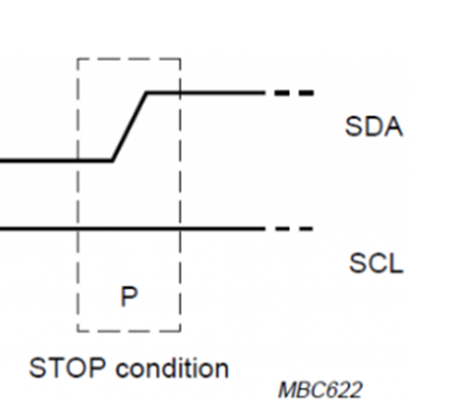
Code of I2C
void Stop_I2c()
{
SDA=0; //发送结束条件的数据信号
_Nop(); //发送结束条件的时钟信号
SCL=1; //结束条件建立时间大于4μ
_Nop();
_Nop();
_Nop();
_Nop();
_Nop();
SDA=1; //发送I2C总线结束信号
_Nop();
_Nop();
_Nop();
_Nop();
}

Slide 31
Code of I2C
void SendByte(unsigned char c)
{
unsigned char BitCnt;
for(BitCnt=0;BitCnt<8;BitCnt++) //要传送的数据长度为8位
{
if((c<<BitCnt)&0x80)SDA=1; //判断发送位
else SDA=0;
_Nop();
SCL=1; //置时钟线为高，通知被控器开始接收数据位
_Nop();
_Nop(); //保证时钟高电平周期大于4μ
_Nop();
_Nop();
_Nop();
SCL=0;
}

Slide 32
Code of I2C
_Nop();
_Nop();
SDA=1; //8位发送完后释放数据线，准备接收应答位
_Nop();
_Nop();
SCL=1;
_Nop();
_Nop();
_Nop();
if(SDA==1)ack=0;
else ack=1; //判断是否接收到应答信号
SCL=0;
_Nop();
_Nop();
}

Slide 33
SMBus
What is the SMBus?
SM Bus ,(System management bus) . It is a two-wire interface based on the I2C bus principle, which is equivalent to a simplified I2C bus for inter-board communication.
The SMBus bus can be connected to a wider variety of device types, including power-related devices, system sensors, and EEPROM capacity.

Slide 34
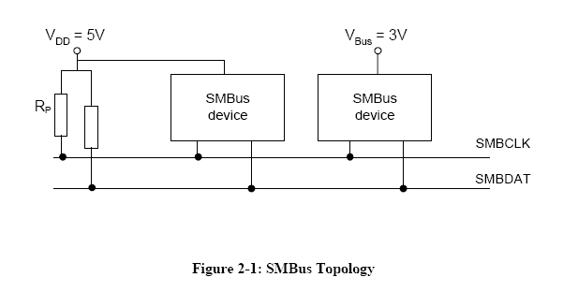
SMBus
The SMBus has three layers:
--physical layer
--data link layer
--network layer

Slide 35
SMBus
SMbus规范定义了两类电气特性，即低功率和高功率。最初在SMBus 1.0和1.1规范中定义的第一类主要是考虑到智能电池而设计的，可以与其他低功耗设备一起使用。该版本的规范引入了另一种更高功率的电气特性。此类适用于需要更高驱动器功能的情况，例如PCI附加卡上的SMBus设备以及用于将这些卡通过PCI连接器彼此之间以及连接到系统板上的SMBus设备。器件可以由总线VDD或另一个电源VBus供电（例如，与智能电池一样），只要它们符合同类产品的SMBus电气规范，它们就可以互操作。
问题：有关于SMbus连接图的具体的解释

Slide 36
SMBus
上图显示了5伏SMBus的示例实现，其中器件由总线VDD供电，与自供电设备互操作
VDD可以是3至5伏+/- 10％，并且SMBus器件可以直接由总线VDD供电。 SMBCLK和SMBDAT线都是双向的，通过上拉电阻或电流源或其他类似电路连接到正电源电压。当总线空闲时，两条线都处于高电平状态。连接到总线的设备的输出级必须具有开漏或开路集电极，以便执行线与功能。在设计SMBus的输入和输出级时应注意为了在其电源平面关闭时不加载总线，即断电设备必须不提供接地的泄漏路径。

Slide 37
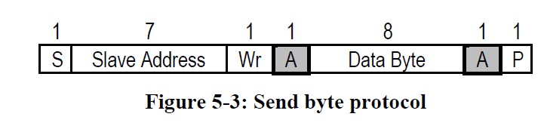
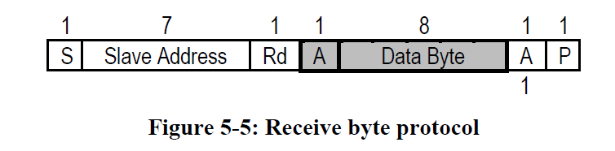
SMBus
Send byte
A simple device may recognize its own slave address and accept up to 256 possible encoded commands in the form of a byte that follows the slave address.
Receive byte
A NACK (a ‘1’ in the ACK bit position) signifies the end of a read transfer.

Slide 38
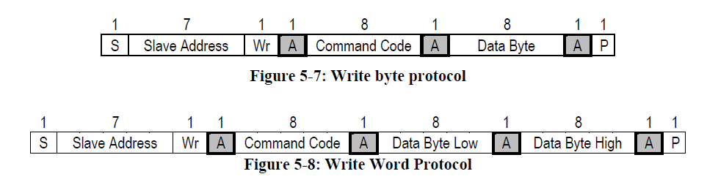
SMBus
Write byte/word
The first byte of a Write Byte/Word access is the command code. The next one or two bytes, respectively, are the data to be written .The slave acknowledges each byte, and the entire transaction is finished with a STOP condition.

Slide 39
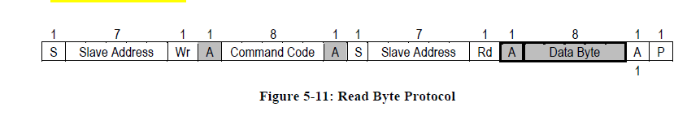
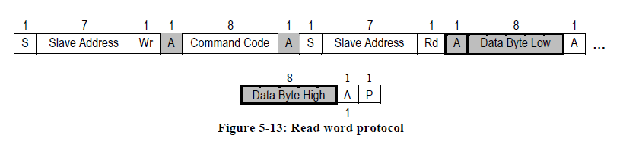
SMBus
Read byte/word
The master must write a command to the slave device.
It must follow that command with a repeated START condition to denote a read from that device’s address.
The slave returns one or two bytes of data.
Note that there is no STOP condition before the repeated START condition, and that a NACK signifies the end of the read transfer.

Slide 40
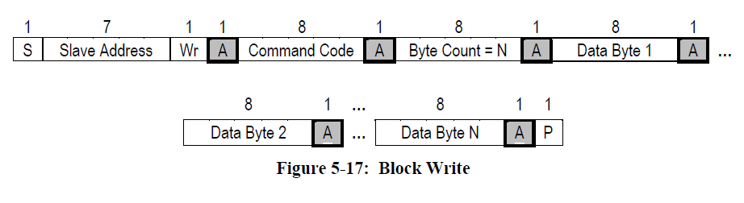
SMBus
Block write
The Block Write begins with a slave address and a write condition. After the command code the host issues a byte count which describes how many more bytes will follow in the message.
A Block Read or Write is allowed to transfer a maximum of 32 data bytes.

Slide 41
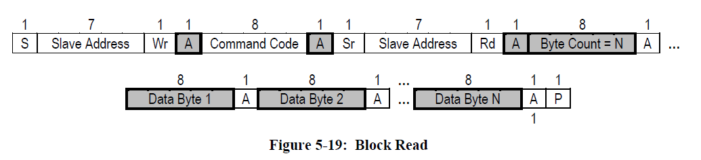
SMBus
Block read
A Block Read differs from a block write in that the repeated START condition exists to satisfy the requirement for a change in the transfer direction. A NACK immediately preceding the STOP condition signifies the end of the read transfer.

Slide 42
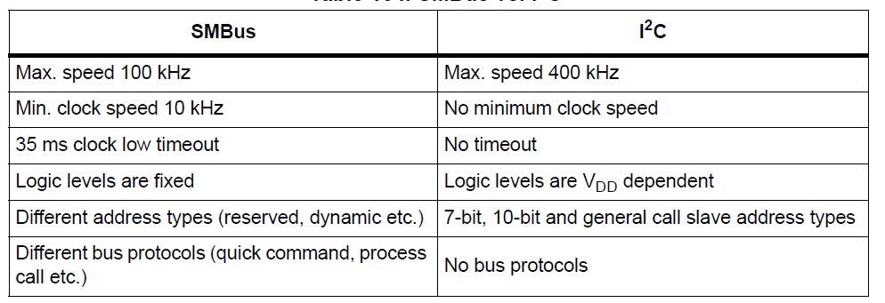
SMBus and I2C
SMbus originated from I2C, but there are major differences in electrical, timing, operating modes, and protocols:

Slide 43
SMBus
问题：SMBus和I2C的区别
I2C起源于电视设计，但之后朝通用路线发展，各种电子设计都有机会用到I2C；而SMBus则在之后为PC所制订的先进组态与电源管理接口（AdvancedConfiguration & Power Interface；ACPI）规范中成为基础的管理讯息传递接口、控制传递接口。
虽然I2C与SMBus先后制订时间不同，但都在2000年左右进入成熟化改版，I2C的过程改版以加速为主要诉求，而SMBus以更切合Smart Battery及ACPI的需求为多。

Slide 44
Thanks !

